Slide 1


DATA ANALYST
PORTFOLIO PROJECT
BANK LOAN ANALYSIS

Slide 2
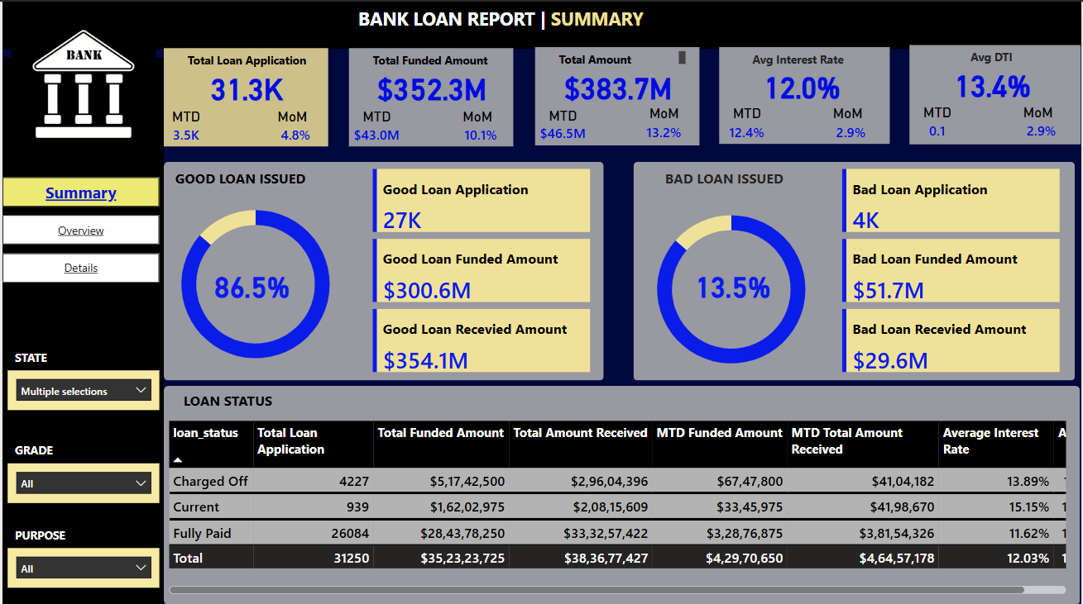

Slide 3
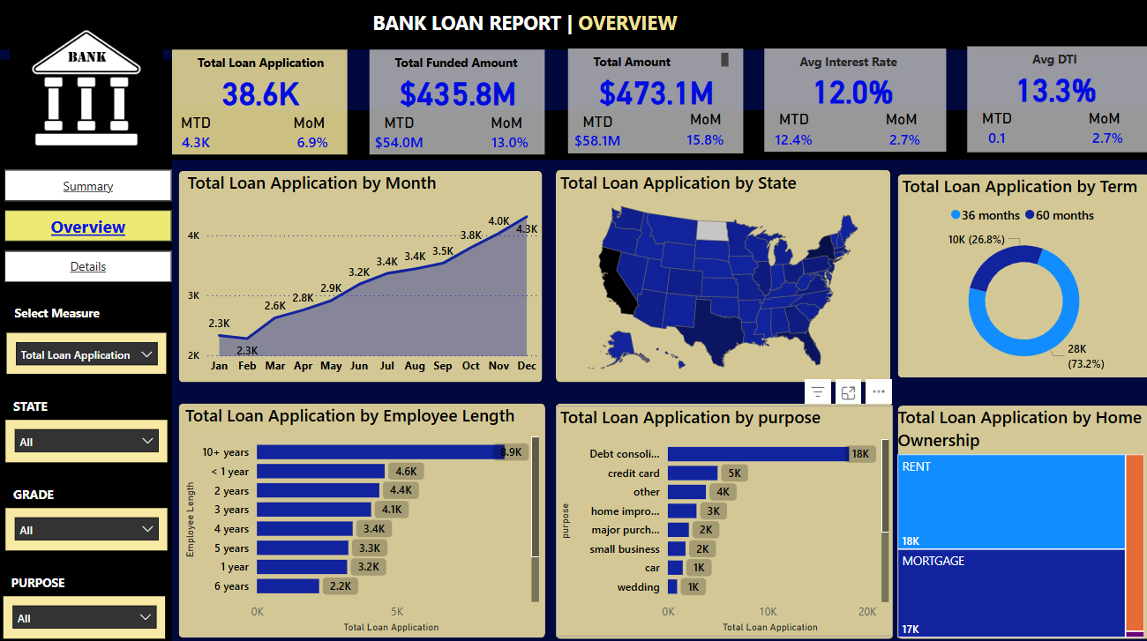

Slide 4
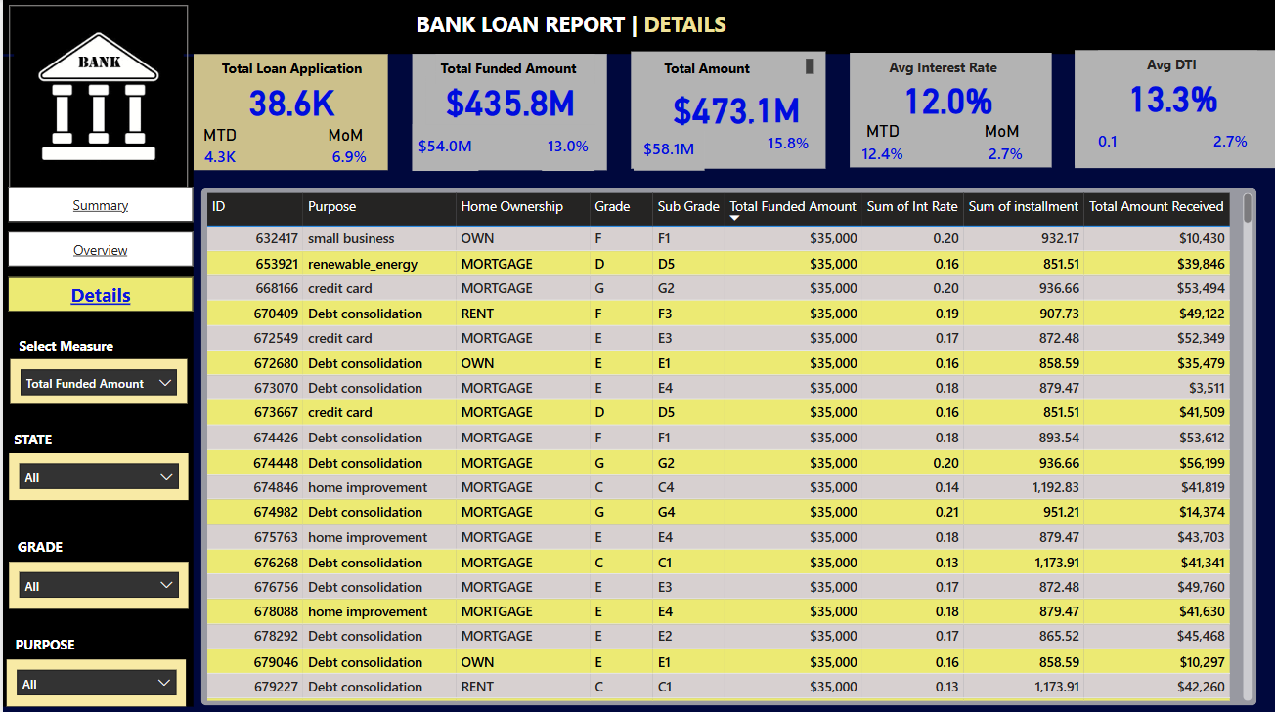

Slide 5
PROBLEM STATEMENT
DASHBOARD 1: SUMMARY
Key Performance Indicators (KPIs) Requirements:
Total Loan Applications: We need to calculate the total number of loan applications received during a specified period. Additionally, it is essential to monitor the Month-to-Date (MTD) Loan Applications and track changes Month-over-Month (MoM).
Total Funded Amount: Understanding the total amount of funds disbursed as loans is crucial. We also want to keep an eye on the MTD Total Funded Amount and analyse the Month-over-Month (MoM) changes in this metric.
Total Amount Received: Tracking the total amount received from borrowers is essential for assessing the bank's cash flow and loan repayment. We should analyse the Month-to-Date (MTD) Total Amount Received and observe the Month-over-Month (MoM) changes.
Average Interest Rate: Calculating the average interest rate across all loans, MTD, and monitoring the Month-over-Month (MoM) variations in interest rates will provide insights into our lending portfolio's overall cost.
Average Debt-to-Income Ratio (DTI): Evaluating the average DTI for our borrowers helps us gauge their financial health. We need to compute the average DTI for all loans, MTD, and track Month-over-Month (MoM) fluctuations.

Slide 6
PROBLEM STATEMENT
DASHBOARD 1: SUMMARY
Good Loan v Bad Loan KPI’s
Good Loan:
Good Loan Application Percentage
Good Loan Applications
Good Loan Funded Amount
Good Loan Total Received Amount
Bad Loan
Bad Loan Application Percentage
Bad Loan Applications
Bad Loan Funded Amount
Bad Loan Total Received Amount
Loan Status Grid View
In order to gain a comprehensive overview of our lending operations and monitor the performance of loans, we aim to create a grid view report categorized by 'Loan Status.’ By providing insights into metrics such as 'Total Loan Applications,' 'Total Funded Amount,' 'Total Amount Received,' 'Month-to-Date (MTD) Funded Amount,' 'MTD Amount Received,' 'Average Interest Rate,' and 'Average Debt-to-Income Ratio (DTI),' this grid view will empower us to make data-driven decisions and assess the health of our loan portfolio.

Slide 7
PROBLEM STATEMENT
DASHBOARD 2: OVERVIEW
CHARTS
Monthly Trends by Issue Date (Line Chart): To identify seasonality and long-term trends in lending activities
Regional Analysis by State (Filled Map): To identify regions with significant lending activity and assess regional disparities
Loan Term Analysis (Donut Chart): To allow the client to understand the distribution of loans across various term lengths.
Employee Length Analysis (Bar Chart): How lending metrics are distributed among borrowers with different employment lengths, helping us assess the impact of employment history on loan applications.
Loan Purpose Breakdown (Bar Chart): Will provide a visual breakdown of loan metrics based on the stated purposes of loans, aiding in the understanding of the primary reasons borrowers seek financing.
Home Ownership Analysis (Tree Map): For a hierarchical view of how home ownership impacts loan applications and disbursements.
Metrics to be shown: 'Total Loan Applications,' 'Total Funded Amount,' and 'Total Amount Received'

Slide 8
PROBLEM STATEMENT
DASHBOARD 3: DETAILS
GRID
Need for a comprehensive 'Details Dashboard' that provides a consolidated view of all the essential information within our loan data. This Details Dashboard aims to offer a holistic snapshot of key loan-related metrics and data points, enabling users to access critical information efficiently.
Objective:
The primary objective of the Details Dashboard is to provide a comprehensive and user-friendly interface for accessing vital loan data. It will serve as a one-stop solution for users seeking detailed insights into our loan portfolio, borrower profiles, and loan performance.

Slide 9
This file contains all the meta information regarding the columns described in the CSV files.
1. dim_date
2. dim_hotels
3. dim_rooms
4. fact_aggregated_bookings
5. fact_bookings
Column Description for dim_date:
1. date: This column represents the dates present in May, June and July.
2. mmm yy: This column represents the date in the format of mmm yy (monthname year).
3. week no: This column represents the unique week number for that particular date.
4. day_type: This column represents whether the given day is Weekend or Weekeday.
Column Description for dim_hotels:
1. property_id: This column represents the Unique ID for each of the hotels.
2. property_name: This column represents the name of each hotel.
3. category: This column determines which class[Luxury, Business] a particular hotel/property belongs to.
4. city: This column represents where the particular hotel/property resides in.

Slide 10
Column Description for fact_aggregated_bookings:
1. property_id: This column represents the Unique ID for each of the hotels.
2. check_in_date: This column represents all the check_in_dates of the customers.
3. room_category: This column represents the type of room[RT1, RT2, RT3, RT4] in a hotel.
4. successful_bookings: This column represents all the successful room bookings that happen for a particular room type in that hotel on that particular date.
5. capacity: This column represents the maximum count of rooms available for a particular room type in that hotel on that particular date.
Column Description for fact_bookings:
1. booking_id: This column represents the Unique Booking ID for each customer when they booked their rooms.
2. property_id: This column represents the Unique ID for each of the hotels
3. booking_date: This column represents the date on which the customer booked their rooms.
4. check_in_date: This column represents the date on which the customer check-in(entered) at the hotel.
5. check_out_date: This column represents the date on which the customer check-out(left) of the hotel.
6. no_guests: This column represents the number of guests who stayed in a particular room in that hotel.
7. room_category: This column represents the type of room[RT1, RT2, RT3, RT4] in a hotel.
8. booking_platform: This column represents in which way the customer booked his room.
9. ratings_given: This column represents the ratings given by the customer for hotel services.
10. booking_status: This column represents whether the customer cancelled his booking[Cancelled], successfully stayed in the hotel[Checked Out] or booked his room but not stayed in the hotel[No show].
11. revenue_generated: This column represents the amount of money generated by the hotel from a particular customer.

Slide 11
DAX Querry used in the Dashboard Measure / column
S.no | Calculated / Column Name | Description/Purpose | DAX Formula | Table
wn | To get the week number from the corresponding date. | wn = WEEKNUM(dim_date[date]) | dim_date | wn
day type | Based on the feedback from stakeholder, we considered Friday and Saturday as weekend and weekdays from Sunday to Thurdsay. In PowerBI, Sunday weekday number is 1, Monday is 2 and so on. So, if weekday number is greater than 5, then weekend or else weekday. https://learn.microsoft.com/en-us/dax/weekday-function-dax | day type = Var wkd = WEEKDAY(dim_date[date],1) return IF( wkd>5,"Weekend","Weekday") | dim_date | day type

Slide 12
Sno | Measures | Description / Purpose | DAX FORMULA | TABLE
1 | Revenue | To get the total revenue_realized | Revenue = SUM(fact_bookings[revenue_realized]) | fact_bookings
2 | Total Bookings | To get the total number of bookings happened | Total Bookings = COUNT(fact_bookings[booking_id]) | fact_bookings
3 | Total Capacity | To get the total capacity of rooms present in hotels | Total Capacity = SUM(fact_aggregated_bookings[capacity]) | fact_aggregated_bookings
4 | Total Succesful Bookings | To get the total succesful bookings happened for all hotels | Total Succesful Bookings = SUM(fact_aggregated_bookings[successful_bookings]) | fact_aggregated_bookings
5 | Occupancy % | Occupancy means total successful bookings happened to the total rooms available(capacity) | Occupancy % = DIVIDE([Total Succesful Bookings],[Total Capacity],0) | fact_aggregated_bookings
6 | Average Rating | Get the average ratings given by the customers | Average Rating = AVERAGE(fact_bookings[ratings_given]) | fact_bookings
7 | No of days | To get the total number of days present in the data. In our case, we have data from May to July. So 92 days. | No of days = DATEDIFF(MIN(dim_date[date]),MAX(dim_date[date]),DAY) +1 | dim_date
8 | Total cancelled bookings | To get the"Cancelled" bookings out of all Total bookings happened | Total cancelled bookings = CALCULATE([Total Bookings],fact_bookings[booking_status]="Cancelled") | fact_bookings
9 | Cancellation % | calculating the cancellaton percentage. | Cancellation % = DIVIDE([Total cancelled bookings],[Total Bookings]) | fact_bookings
10 | Total Checked Out | To get the successful 'Checked out' bookings out of all Total bookings happened | Total Checked Out = CALCULATE([Total Bookings],fact_bookings[booking_status]="Checked Out") | fact_bookings
11 | Total no show bookings | To get the"No Show" bookings out of all Total bookings happened ("No show" means those customers who neither cancelled nor attend to their booked rooms) | Total no show bookings = CALCULATE([Total Bookings],fact_bookings[booking_status]="No Show") | fact_bookings

Slide 13
12 | No Show rate % | calculating the no show percentage. | No Show rate % = DIVIDE([Total no show bookings],[Total Bookings]) | fact_bookings
13 | Booking % by Platform | To show the percentage contribution of each booking platform for bookings in hotels. We have booking platforms like makeyourtrip, logtrip, tripster etc) | Booking % by Platform = DIVIDE([Total Bookings], CALCULATE([Total Bookings], ALL(fact_bookings[booking_platform]) ))*100 | fact_bookings
14 | Booking % by Room class | To show the percentage contribution of each room class over total rooms booked. We have room classes like Standard, Elite, Premium, Presidential. | Booking % by Room class = DIVIDE([Total Bookings], CALCULATE([Total Bookings], ALL(dim_rooms[room_class]) ))*100 | fact_bookings, dim_rooms
15 | ADR | Calculate the ADR(Average Daily rate) It is the ratio of revenue to the total rooms booked/sold. It is the measure of the average paid for rooms sold in a given time period | ADR = DIVIDE( [Revenue], [Total Bookings],0) | fact_bookings
16 | Realisation % | calculate the realisation percentage. It is nothing but the succesful "checked out" percentage over all bookings happened. | Realisation % = 1- ([Cancellation %]+[No Show rate %]) | fact_bookings
17 | RevPAR | Calculate the RevPAR(Revenue Per Available Room) RevPAR represents the revenue generated per available room, whether or not they are occupied. RevPAR helps hotels measure their revenue generating performance to accurately price rooms. RevPAR can help hotels measure themselves against other properties or brands. | RevPAR = DIVIDE([Revenue],[Total Capacity]) | fact_bookings, fact_agg_bookings
18 | DBRN | calculate DBRN(Daily Booked Room Nights) This metrics tells on average how many rooms are booked for a day considering a time period | DBRN = DIVIDE([Total Bookings], [No of days]) | fact_bookings, dim_date
19 | DSRN | calculate DSRN(Daily Sellable Room Nights) This metrics tells on average how many rooms are ready to sell for a day considering a time period | DSRN = DIVIDE([Total Capacity], [No of days]) | fact_agg_bookings, dim_date
20 | DURN | calculate DURN(Daily Utilized Room Nights) This metric tells on average how many rooms are succesfully utilized by customers for a day considering a time period | DURN = DIVIDE([Total Checked Out],[No of days]) | fact_bookings, dim_date
21 | Revenue WoW change % | To get the revenue change percentage week over week. Here, revcw for current week revpw for previous week | Revenue WoW change % = Var selv = IF(HASONEFILTER(dim_date[wn]),SELECTEDVALUE(dim_date[wn]),MAX(dim_date[wn])) var revcw = CALCULATE([Revenue],dim_date[wn]= selv) var revpw = CALCULATE([Revenue],FILTER(ALL(dim_date),dim_date[wn]= selv-1)) return DIVIDE(revcw,revpw,0)-1 | dim_date
12 | No Show rate % | calculating the no show percentage. | No Show rate % = DIVIDE([Total no show bookings],[Total Bookings]) | fact_bookings
13 | Booking % by Platform | To show the percentage contribution of each booking platform for bookings in hotels. We have booking platforms like makeyourtrip, logtrip, tripster etc) | Booking % by Platform = DIVIDE([Total Bookings], CALCULATE([Total Bookings], ALL(fact_bookings[booking_platform]) ))*100 | fact_bookings

Slide 14
18 | DBRN | calculate DBRN(Daily Booked Room Nights) This metrics tells on average how many rooms are booked for a day considering a time period | DBRN = DIVIDE([Total Bookings], [No of days]) | fact_bookings, dim_date
19 | DSRN | calculate DSRN(Daily Sellable Room Nights) This metrics tells on average how many rooms are ready to sell for a day considering a time period | DSRN = DIVIDE([Total Capacity], [No of days]) | fact_agg_bookings, dim_date
20 | DURN | calculate DURN(Daily Utilized Room Nights) This metric tells on average how many rooms are succesfully utilized by customers for a day considering a time period | DURN = DIVIDE([Total Checked Out],[No of days]) | fact_bookings, dim_date
21 | Revenue WoW change % | To get the revenue change percentage week over week. Here, revcw for current week revpw for previous week | Revenue WoW change % = Var selv = IF(HASONEFILTER(dim_date[wn]),SELECTEDVALUE(dim_date[wn]),MAX(dim_date[wn])) var revcw = CALCULATE([Revenue],dim_date[wn]= selv) var revpw = CALCULATE([Revenue],FILTER(ALL(dim_date),dim_date[wn]= selv-1)) return DIVIDE(revcw,revpw,0)-1 | dim_date
22 | Occupancy WoW change % | To get the occupancy change percentage week over week. Here, revcw for current week revpw for previous week | Occupancy WoW change % = Var selv = IF(HASONEFILTER(dim_date[wn]),SELECTEDVALUE(dim_date[wn]),MAX(dim_date[wn])) var revcw = CALCULATE([Occupancy %],dim_date[wn]= selv) var revpw = CALCULATE([Occupancy %],FILTER(ALL(dim_date),dim_date[wn]= selv-1)) return DIVIDE(revcw,revpw,0)-1 | dim_date
23 | ADR WoW change % | To get the ADR(Average Daily rate) change percentage week over week. Here, revcw for current week revpw for previous week | ADR WoW change % = Var selv = IF(HASONEFILTER(dim_date[wn]),SELECTEDVALUE(dim_date[wn]),MAX(dim_date[wn])) var revcw = CALCULATE([ADR],dim_date[wn]= selv) var revpw = CALCULATE([ADR],FILTER(ALL(dim_date),dim_date[wn]= selv-1)) return DIVIDE(revcw,revpw,0)-1 | dim_date
24 | Revpar WoW change % | To get the RevPar(Revenue Per Available Room) change percentage week over week. Here, revcw for current week revpw for previous week | Revpar WoW change % = Var selv = IF(HASONEFILTER(dim_date[wn]),SELECTEDVALUE(dim_date[wn]),MAX(dim_date[wn])) var revcw = CALCULATE([RevPAR],dim_date[wn]= selv) var revpw = CALCULATE([RevPAR],FILTER(ALL(dim_date),dim_date[wn]= selv-1)) return DIVIDE(revcw,revpw,0)-1 | dim_date
25 | Realisation WoW change % | To get the Realisation change percentage week over week. Here, revcw for current week revpw for previous week | Realisation WoW change % = Var selv = IF(HASONEFILTER(dim_date[wn]),SELECTEDVALUE(dim_date[wn]),MAX(dim_date[wn])) var revcw = CALCULATE([Realisation %],dim_date[wn]= selv) var revpw = CALCULATE([Realisation %],FILTER(ALL(dim_date),dim_date[wn]= selv-1)) return DIVIDE(revcw,revpw,0)-1 | dim_date
26 | DSRN WoW change % | To get the DSRN(Daily Sellable Room Nights) change percentage week over week. Here, revcw for current week revpw for previous week | DSRN WoW change % = Var selv = IF(HASONEFILTER(dim_date[wn]),SELECTEDVALUE(dim_date[wn]),MAX(dim_date[wn])) var revcw = CALCULATE([DSRN],dim_date[wn]= selv) var revpw = CALCULATE([DSRN],FILTER(ALL(dim_date),dim_date[wn]= selv-1)) return DIVIDE(revcw,revpw,0)-1 | dim_date

Slide 15
22 | Occupancy WoW change % | To get the occupancy change percentage week over week. Here, revcw for current week revpw for previous week | Occupancy WoW change % = Var selv = IF(HASONEFILTER(dim_date[wn]),SELECTEDVALUE(dim_date[wn]),MAX(dim_date[wn])) var revcw = CALCULATE([Occupancy %],dim_date[wn]= selv) var revpw = CALCULATE([Occupancy %],FILTER(ALL(dim_date),dim_date[wn]= selv-1)) return DIVIDE(revcw,revpw,0)-1 | dim_date
23 | ADR WoW change % | To get the ADR(Average Daily rate) change percentage week over week. Here, revcw for current week revpw for previous week | ADR WoW change % = Var selv = IF(HASONEFILTER(dim_date[wn]),SELECTEDVALUE(dim_date[wn]),MAX(dim_date[wn])) var revcw = CALCULATE([ADR],dim_date[wn]= selv) var revpw = CALCULATE([ADR],FILTER(ALL(dim_date),dim_date[wn]= selv-1)) return DIVIDE(revcw,revpw,0)-1 | dim_date
24 | Revpar WoW change % | To get the RevPar(Revenue Per Available Room) change percentage week over week. Here, revcw for current week revpw for previous week | Revpar WoW change % = Var selv = IF(HASONEFILTER(dim_date[wn]),SELECTEDVALUE(dim_date[wn]),MAX(dim_date[wn])) var revcw = CALCULATE([RevPAR],dim_date[wn]= selv) var revpw = CALCULATE([RevPAR],FILTER(ALL(dim_date),dim_date[wn]= selv-1)) return DIVIDE(revcw,revpw,0)-1 | dim_date
25 | Realisation WoW change % | To get the Realisation change percentage week over week. Here, revcw for current week revpw for previous week | Realisation WoW change % = Var selv = IF(HASONEFILTER(dim_date[wn]),SELECTEDVALUE(dim_date[wn]),MAX(dim_date[wn])) var revcw = CALCULATE([Realisation %],dim_date[wn]= selv) var revpw = CALCULATE([Realisation %],FILTER(ALL(dim_date),dim_date[wn]= selv-1)) return DIVIDE(revcw,revpw,0)-1 | dim_date
26 | DSRN WoW change % | To get the DSRN(Daily Sellable Room Nights) change percentage week over week. Here, revcw for current week revpw for previous week | DSRN WoW change % = Var selv = IF(HASONEFILTER(dim_date[wn]),SELECTEDVALUE(dim_date[wn]),MAX(dim_date[wn])) var revcw = CALCULATE([DSRN],dim_date[wn]= selv) var revpw = CALCULATE([DSRN],FILTER(ALL(dim_date),dim_date[wn]= selv-1)) return DIVIDE(revcw,revpw,0)-1 | dim_date
22 | Occupancy WoW change % | To get the occupancy change percentage week over week. Here, revcw for current week revpw for previous week | Occupancy WoW change % = Var selv = IF(HASONEFILTER(dim_date[wn]),SELECTEDVALUE(dim_date[wn]),MAX(dim_date[wn])) var revcw = CALCULATE([Occupancy %],dim_date[wn]= selv) var revpw = CALCULATE([Occupancy %],FILTER(ALL(dim_date),dim_date[wn]= selv-1)) return DIVIDE(revcw,revpw,0)-1 | dim_date
23 | ADR WoW change % | To get the ADR(Average Daily rate) change percentage week over week. Here, revcw for current week revpw for previous week | ADR WoW change % = Var selv = IF(HASONEFILTER(dim_date[wn]),SELECTEDVALUE(dim_date[wn]),MAX(dim_date[wn])) var revcw = CALCULATE([ADR],dim_date[wn]= selv) var revpw = CALCULATE([ADR],FILTER(ALL(dim_date),dim_date[wn]= selv-1)) return DIVIDE(revcw,revpw,0)-1 | dim_date
24 | Revpar WoW change % | To get the RevPar(Revenue Per Available Room) change percentage week over week. Here, revcw for current week revpw for previous week | Revpar WoW change % = Var selv = IF(HASONEFILTER(dim_date[wn]),SELECTEDVALUE(dim_date[wn]),MAX(dim_date[wn])) var revcw = CALCULATE([RevPAR],dim_date[wn]= selv) var revpw = CALCULATE([RevPAR],FILTER(ALL(dim_date),dim_date[wn]= selv-1)) return DIVIDE(revcw,revpw,0)-1 | dim_date
25 | Realisation WoW change % | To get the Realisation change percentage week over week. Here, revcw for current week revpw for previous week | Realisation WoW change % = Var selv = IF(HASONEFILTER(dim_date[wn]),SELECTEDVALUE(dim_date[wn]),MAX(dim_date[wn])) var revcw = CALCULATE([Realisation %],dim_date[wn]= selv) var revpw = CALCULATE([Realisation %],FILTER(ALL(dim_date),dim_date[wn]= selv-1)) return DIVIDE(revcw,revpw,0)-1 | dim_date
26 | DSRN WoW change % | To get the DSRN(Daily Sellable Room Nights) change percentage week over week. Here, revcw for current week revpw for previous week | DSRN WoW change % = Var selv = IF(HASONEFILTER(dim_date[wn]),SELECTEDVALUE(dim_date[wn]),MAX(dim_date[wn])) var revcw = CALCULATE([DSRN],dim_date[wn]= selv) var revpw = CALCULATE([DSRN],FILTER(ALL(dim_date),dim_date[wn]= selv-1)) return DIVIDE(revcw,revpw,0)-1 | dim_date
22 | Occupancy WoW change % | To get the occupancy change percentage week over week. Here, revcw for current week revpw for previous week | Occupancy WoW change % = Var selv = IF(HASONEFILTER(dim_date[wn]),SELECTEDVALUE(dim_date[wn]),MAX(dim_date[wn])) var revcw = CALCULATE([Occupancy %],dim_date[wn]= selv) var revpw = CALCULATE([Occupancy %],FILTER(ALL(dim_date),dim_date[wn]= selv-1)) return DIVIDE(revcw,revpw,0)-1 | dim_date
23 | ADR WoW change % | To get the ADR(Average Daily rate) change percentage week over week. Here, revcw for current week revpw for previous week | ADR WoW change % = Var selv = IF(HASONEFILTER(dim_date[wn]),SELECTEDVALUE(dim_date[wn]),MAX(dim_date[wn])) var revcw = CALCULATE([ADR],dim_date[wn]= selv) var revpw = CALCULATE([ADR],FILTER(ALL(dim_date),dim_date[wn]= selv-1)) return DIVIDE(revcw,revpw,0)-1 | dim_date

Slide 16
Thank You!
I sincerely appreciate your time and effort in reviewing this Bank Loan Status Dashboard. This report is designed to provide clear insights into loan performance, trends, and status updates, helping in better decision-making and financial planning.
If you have any questions or need further clarifications, please feel free to reach out.
Thank you for your attention!
- Arif Ansari

